Slide 1
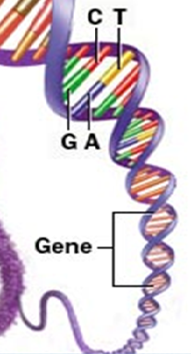
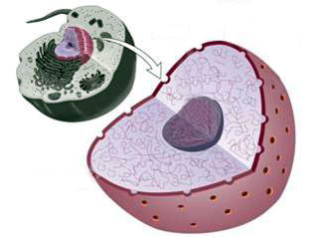
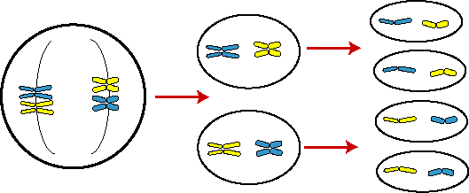
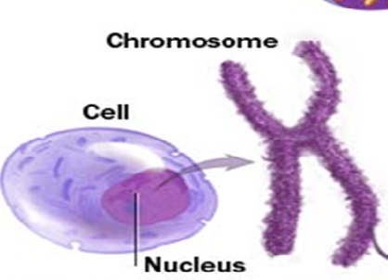
Nucleus :
Nucleus is covered by a double layered covering called nuclear membrane.
The nuclear membrane has pores which allow transfer of material from inside the nucleus to its outside i.e. cytoplasm.
Nucleus is a large spherical body generally lying at the center of the cell.
DNA molecules transfer the hereditary information from one generation to the next.
For eg. Colour of the eye, colour of the hair etc.
The nucleoplasm contains one or more round shaped nucleoli (singular nucleolus).
It is the most important part of the cell.
Functional segments of DNA are called Genes.
It controls all the cellular activities and also plays an important role in cell division.
Generally one gene controls one or more cell functions but some times a single function is control by a set of gene.
Jelly like fluid inside the nucleus
It also contains a network of fibres called chromatin fibres.
Nuclear membrane
It decides what function a cell will carry out after maturation.
Nucleolus
Nuclear pores
Chromosomes are visible as rod-shaped structures when the cell about to divide.
thin thread like structures composed of DNA and protein.
Under electron microscope the nucleus is covered by a double membrane called nuclear membrane.
Chromosomes are made up of DNA. (Deoxyribose nucliec acid)
Chromatin fibres

Slide 2

Functions of nucleus :
It controls metabolic activities of the cell. If it is removed, the cell ultimately dies.
Functions
Nucleus control cell division.
It is involved in transmission of hereditary characters from parents to offsprings.
Children

